Slide 1
Preprocessing
1
2
3
Red Light Camera Dataframe RL_df
Killed or Seriously Injured DF
KSI_df
Red Light Camera + KSI
Geomerge_df
Inspect the initial dataframe reviewing the shape and info
Dropped unnecessary columns
The geometry field was parsed so that Latitude & Longitude could be used to match records between the red light camera file and the killed seriously injured file. The geometry field contained geo-coordinates in a JSON string format. A two-step process was employed. The first step was to first extract the numeric string and then to split the numeric string into Latitude and Longitude and place these values in their own columns.
Inspect the initial dataframe reviewing the shape and info
The file contains duplicate accident records where each row represents a person involved in the accident. The dataframe contains person specific columns and accident specific columns. The next few actions involved cleaning the data so that a single record remained
Updates were made to a subset of specific records where nulls were converted to “Other” & unnecessary columns dropped
The next few steps involved converting categorical values into 1’s and 0’s. A variety of lambda and other approaches were taken to perform this activity.
IsRedLight column added to KSI_df and set to zero
Redlight toggle function created
Geomerge_df created from RF_df & KSI_df merge on Latitude & Longitude – now contains all records where a redlight camera is present
Geomerge_df mapped to KSI dataframe toggling the IsRedlight value from a 0 to a 1
Notes:
https://www.entrepreneur.com/article/253169

Slide 2
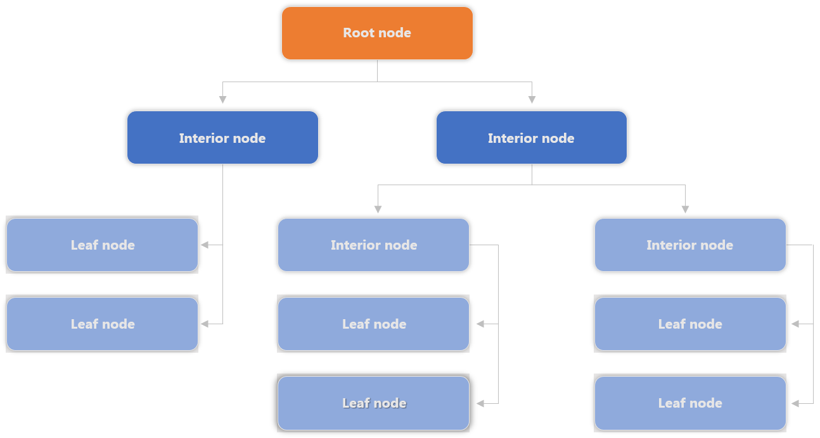
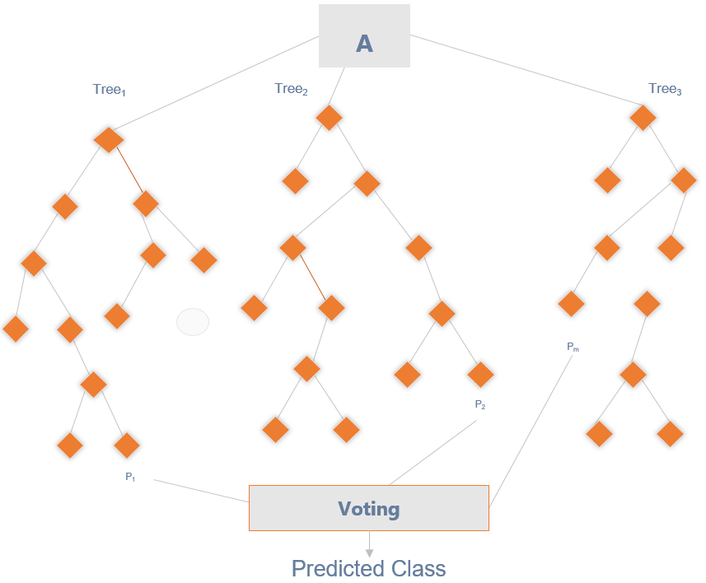
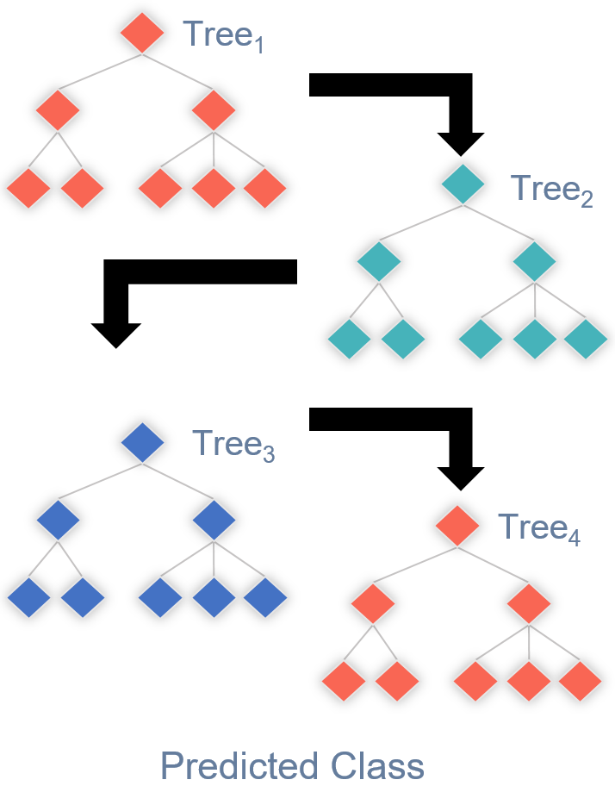
Models
Decision Tree
Random Forest
Gradient Boost
Benefits: An easy interpretive model. Easy to classify or label objects.
Drawbacks: It can become very large very quickly. Deep and complex trees tend to overfit to the data and does not generalize well.
Benefits: A random forest algorithm will sample the data and build several smaller, simpler decision trees. Has a reduced risk of overfitting.
Drawbacks: The main limitation of random forest is that a large number of trees can make the algorithm too slow and ineffective for real-time predictions. In general, these algorithms are fast to train, but quite slow to create predictions once they are trained.
Benefits: Works well with unbalanced classes. Boosting also can improve model predictions for learning algorithms. The weak learners are sequentially corrected by their predecessors, and, in the process, they are converted into strong learners.
Drawbacks: Sensitive to outliers since every classifier is obliged to fix the errors in the predecessors.
Notes:
https://www.entrepreneur.com/article/253169

Slide 3
Model Selection
Random Forest
As we know where the cameras are already installed, we will use the factors of the accidents at those locations to train our model to predict the location of red-light cameras based on the factors of traffic accidents. As there are many factors that affects a collision in an intersection, using a random forest enables feature randomness when building individual trees, to which the forest will make a more accurate prediction by committee.
Gradient Boosting
As major and more severe collisions occur infrequently compared to the whole scope of collisions, the model we build may hold some form of bias and skewness. In other words, the random forest may produce predictions solely on the factors that affect minor collisions. This would mean the false negatives could be locations where major accidents had occurred, and the camera could be impacting such collisions. Thus, we will also test and employ gradient boosting. Gradient boosting will weight the observations and put more weight on the major collisions and less on minor collisions as they will already be handled well during training. This should reduce the bias and skewness of the model.
Notes:
https://www.entrepreneur.com/article/253169

Slide 4
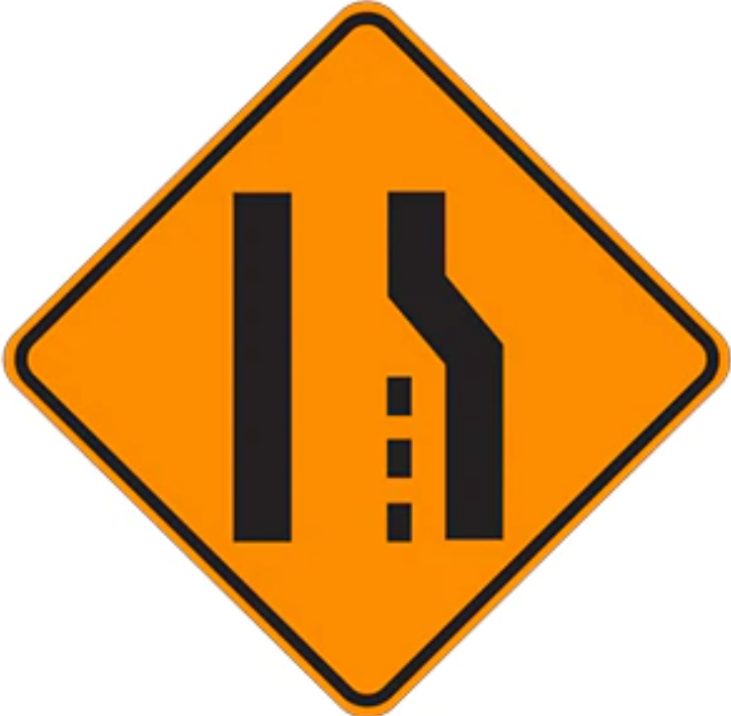
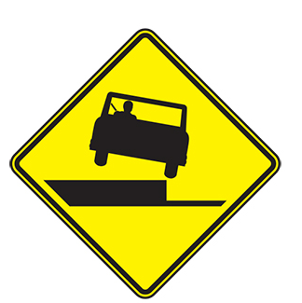
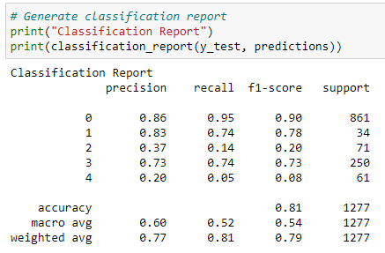
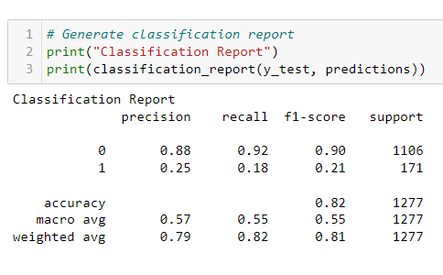
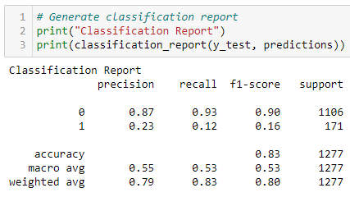
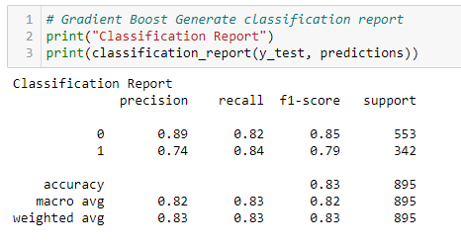
Machine Learning Steps Taken
Step
Step
Step
Step
Step
Run models with all data with injury type target
Target Accident Class
Refine Change encoding
Refine Remove Features
Success Use Over & Under-sampling
Results indicate over fitting and unclear results. Need to rethink the target. Pivot to use Accident Class.
Continued with label encoding. High F1, precision & recall on Non-Fatal predictions. Poor Fatal predictions.
Dig-in and make changes to remove any bias in the category encoding switch to one hot encoding from Label encoding
Remove features related to driver and focus on overall accident features
Correct class imbalance by over sampling fatalities and under sampling non-fatal accidents
Notes:
https://www.entrepreneur.com/article/253169

Slide 5
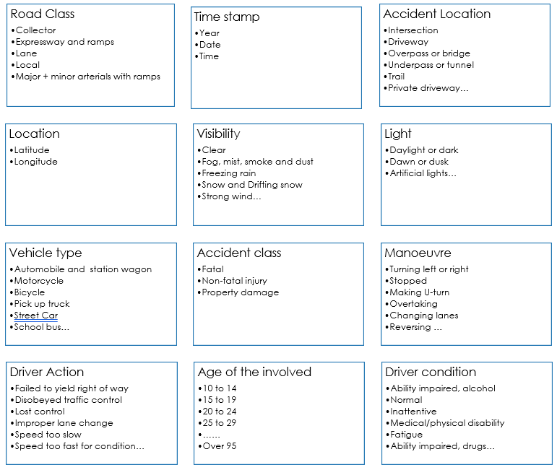
Machine Learning Steps Taken
The first stage involved keeping the majority of features with a few exceptions where the data could not be defined.
The data definitions for each raw file are found in the dataset folder
The models were pre-selected and include:
Random Forest
Gradient Boosted Tree
A size for the split into training and testing sets was not specified and therefore defaults to 25% with scikit-learn. Using Train_size or test_size the split can be specified.
The net result of this first run produced good performance on 3 of the 5 targets.
Step
Notes:
https://www.entrepreneur.com/article/253169

Slide 6
Machine Learning Steps Taken
This initial ML model run in step 1 was muddled. The some of the features were specific to the person involved in the accident and some of the features applied to the overall accident.
At this stage feature selection became very important. A decision was made to only run the model based on overall accident features and exclude individual participant features.
The target changed from Injury type (specific to the person) to Accident Class (specific to the accident)
Classification report shows High F1, precision & recall on Non-Fatal predictions however the model performs poorly on Fatal predictions.
Step
Notes:
https://www.entrepreneur.com/article/253169

Slide 7
Machine Learning Steps Taken
+
Step
Step
Refinement
These steps involved making additional decisions:
Based on feature importance rankings additional features which had no impact on results were dropped.
The encoding method was changed from Label Encoder to One Hot Encoder because some categorical columns had a high number of categories. This change ensured there was no ranking of the values because everything is a 1 or a 0 instead of a numerical range
Classification report shows no real improvement over step 2. There is still a high F1, precision & recall score on Non-Fatal predictions however the model performs poorly on Fatal predictions.
Notes:
https://www.entrepreneur.com/article/253169

Slide 8

Machine Learning Steps Taken
Class imbalance was having a big impact on the ML model performance where it was being skewed by the high number of non-fatal records
To correct for this over sampling and under sampling was employed through trial and error and included:
Randomly extracting 50 records of each target and running the ML
Under-sampling the non-fatal records
Over-sampling the fatal accidents
The best result was doubling the fatal records and cutting in half the non-fatal records.
Success at last…
The F1 scores on both fatal and non-fatal predictions is high
Precision and recall are equally good
Step
Notes:
https://www.entrepreneur.com/article/253169

Slide 9
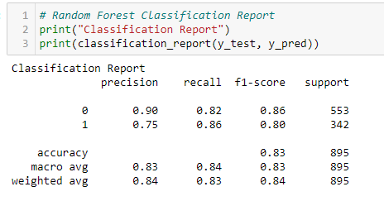




Dashboard
Random Forest
Using the Model to Make Predictions
1
10 Intersection at 6pm
2
Input Speeding variable as Yes or No
3
Result: 6 out of the 10 intersections predict fatalities
Gradient Boost
4
Decision: Install Redlight camera or other controls
5
Iterate on other features to predict
outcomes
Notes:
https://www.entrepreneur.com/article/253169

